Slide 1

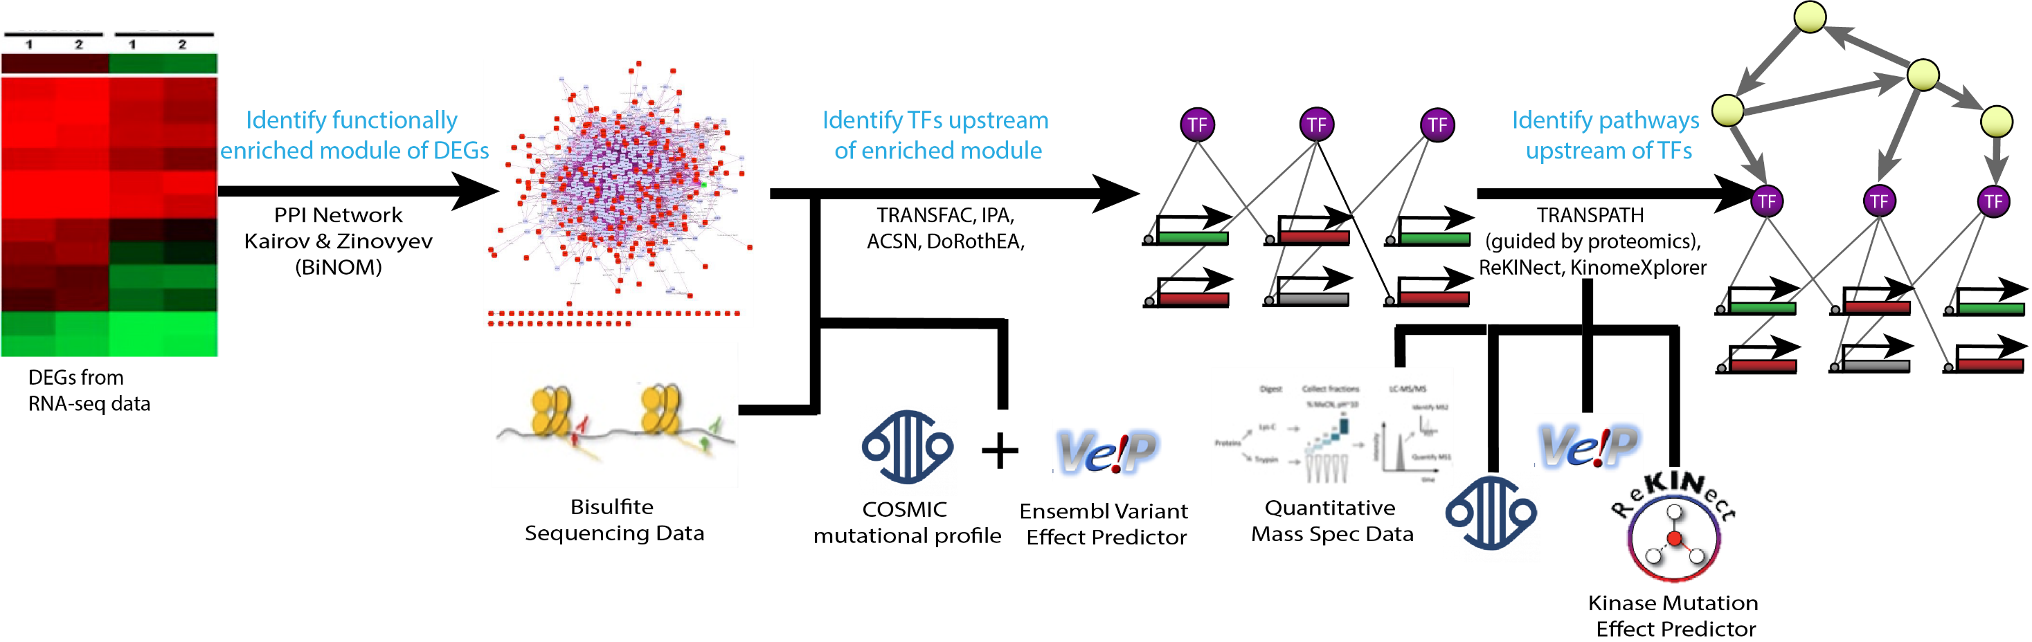
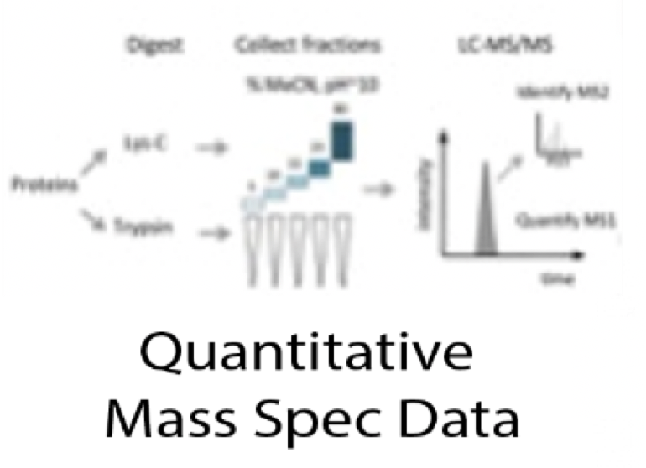
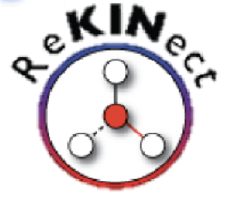



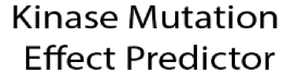
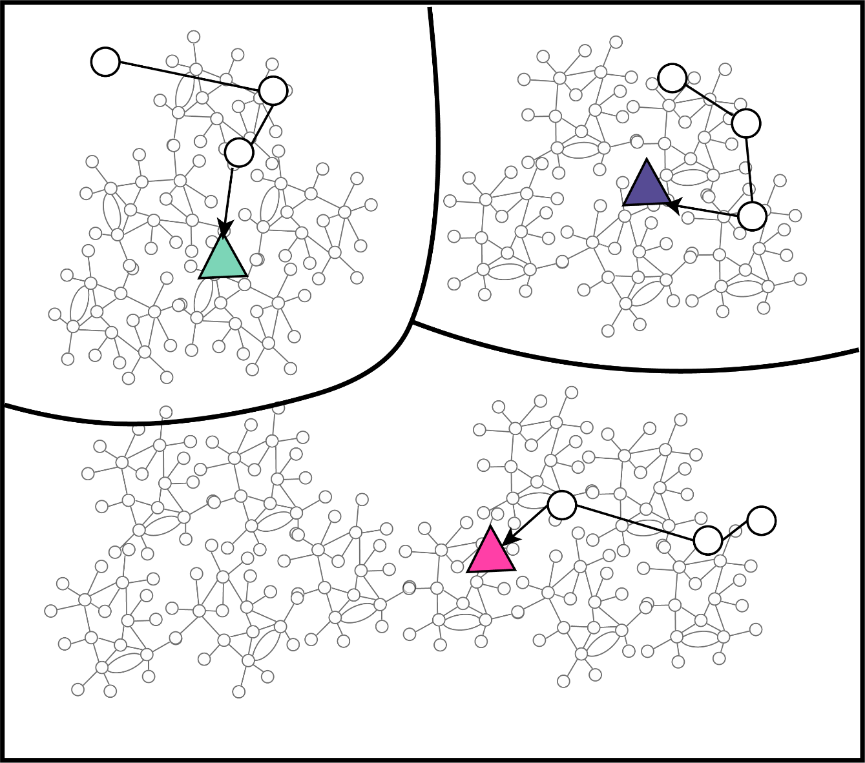
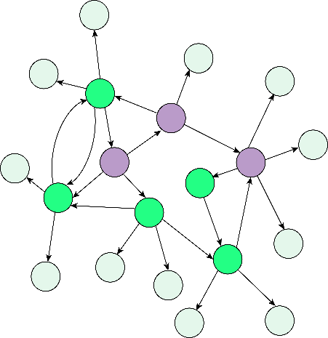

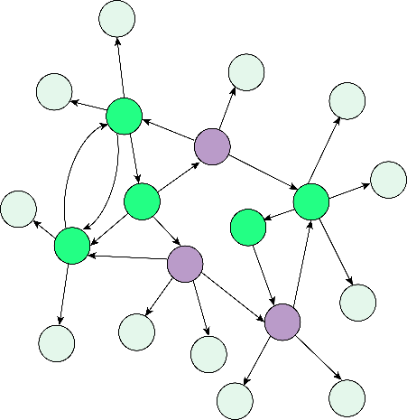
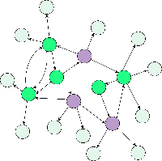
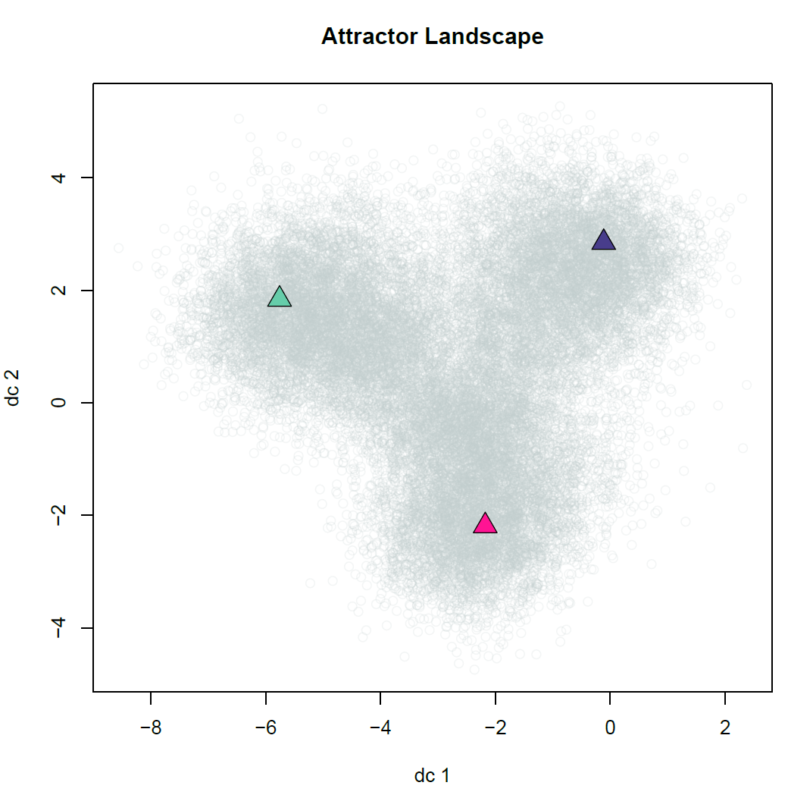
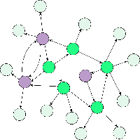
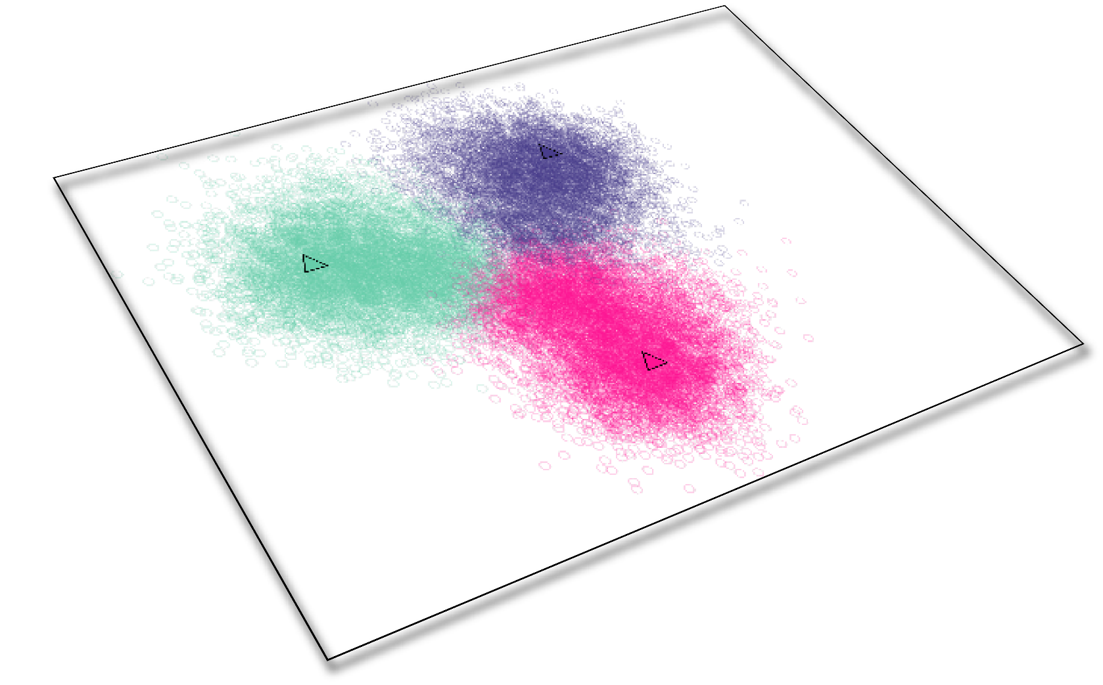
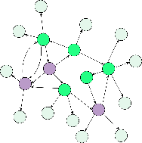
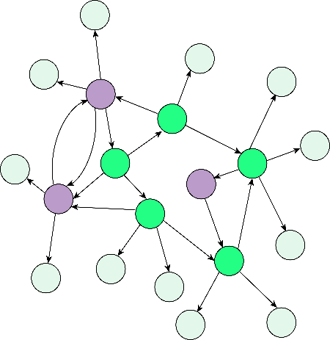

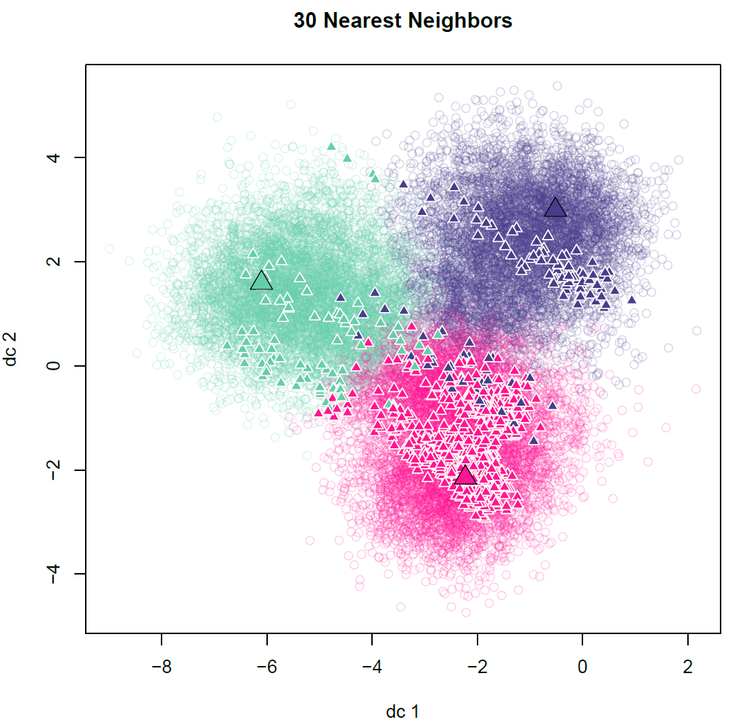
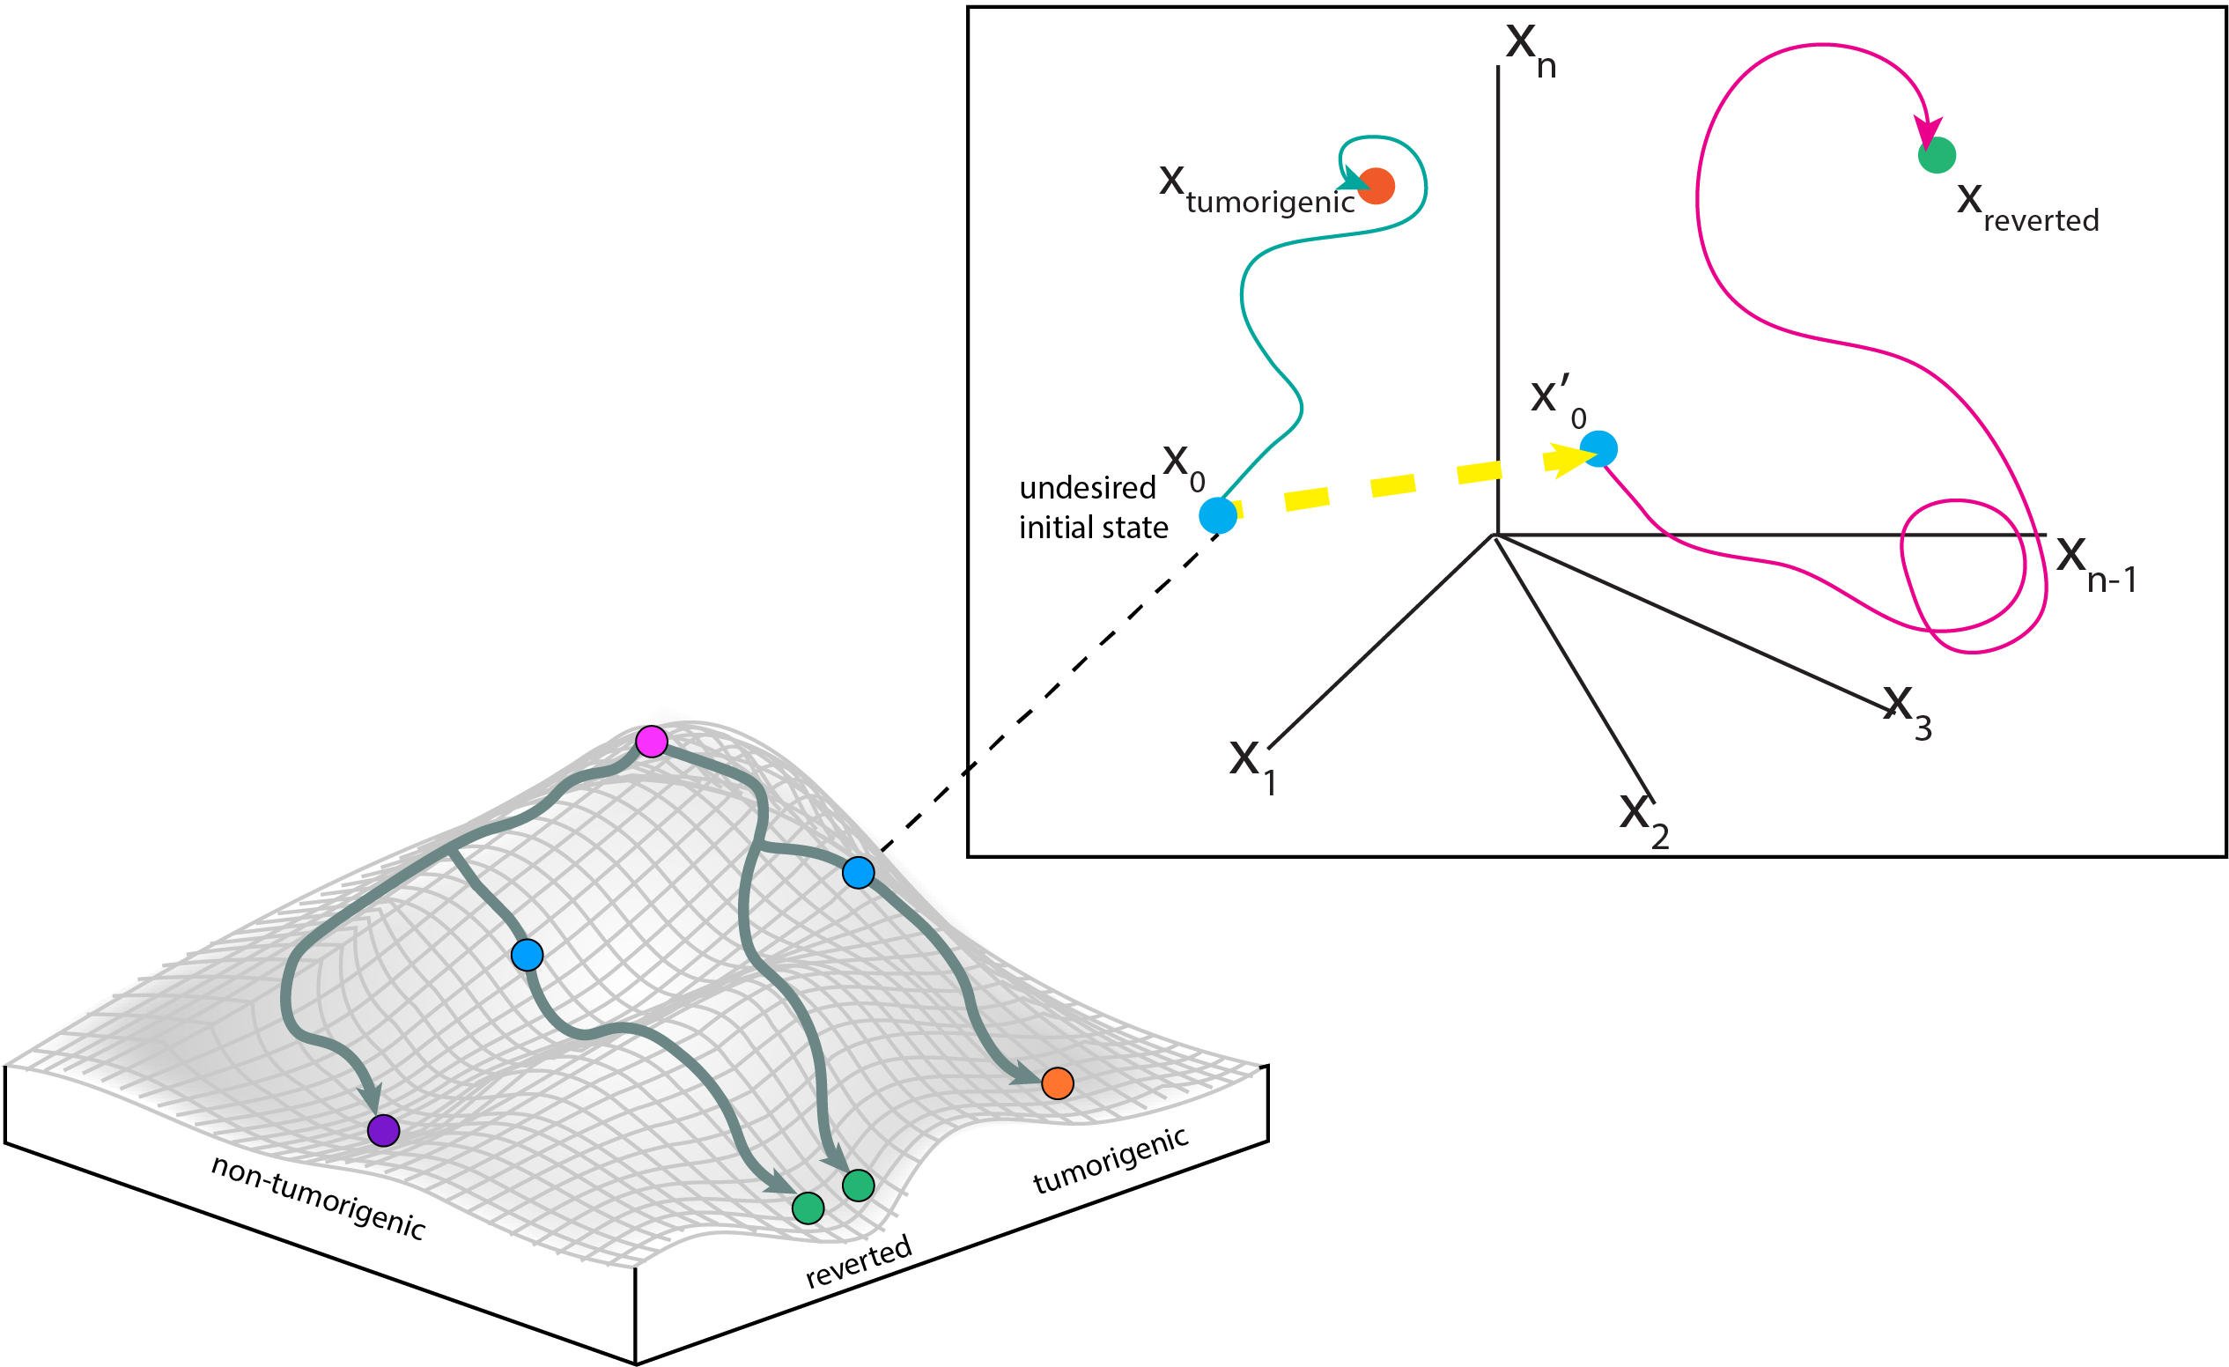
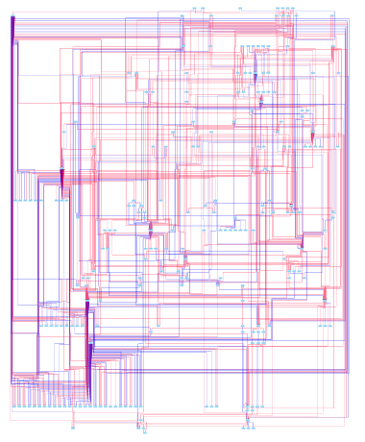
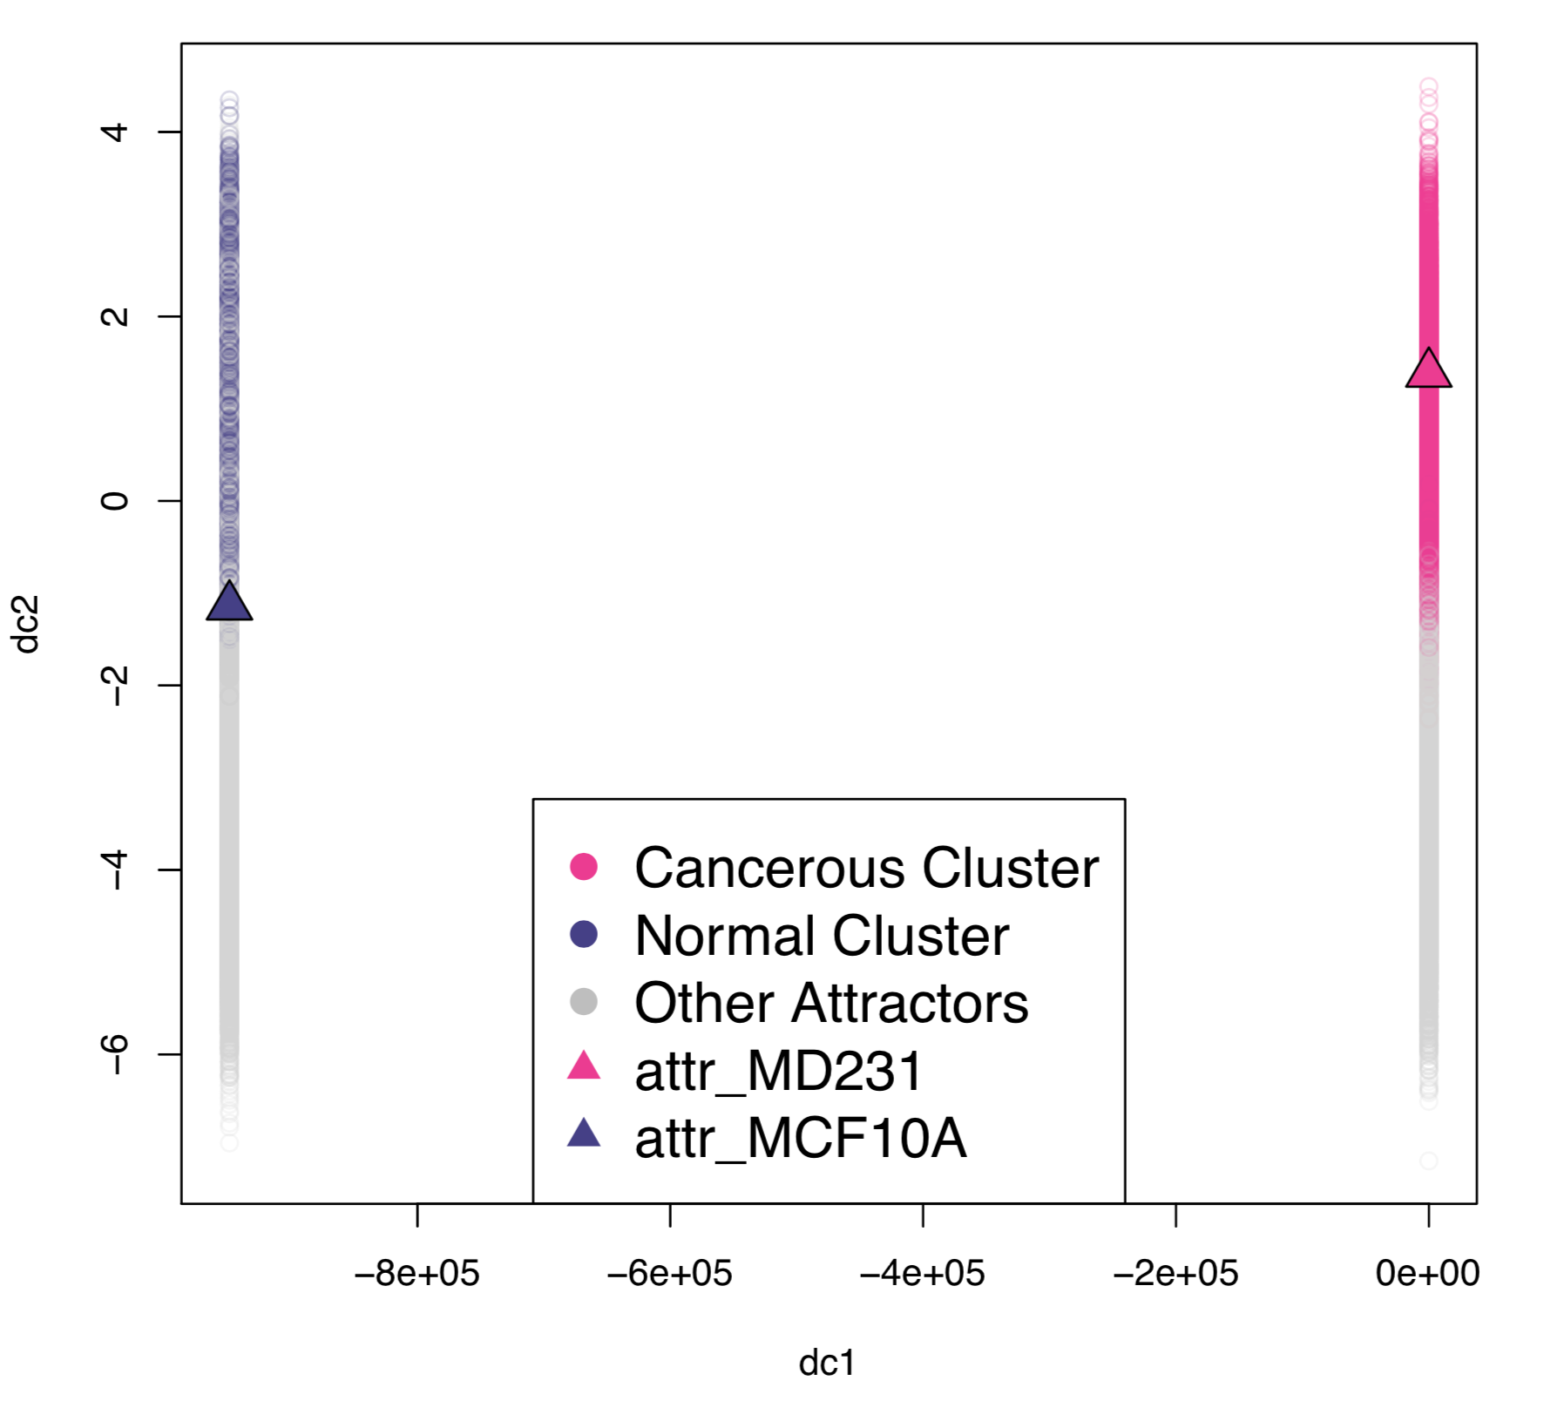
Identification of Combinations of Targets for Claudin-Low Triple Negative Breast Cancer Reversion
Madeleine S. Gastonguay¹, Lauren Marazzi¹, Paola Vera-Licona¹
Center for Quantitative Medicine, UConn Health, Farmington CT 06030
INTRODUCTION
METHODS
Claudin-Low Triple Negative Breast Cancer (CL TNBC) is an aggressive subtype of TNBC with a poor prognosis^{1,2,5} (Fig 1). Current breast cancer therapies are not effective in treating this tumor, creating the need for a new therapeutic approach.
STEP 1. Reconstruction of Tumorigenic Network. RNA-seq data¹⁹ for the CL TNBC cell line MDA-MB-231 and the normal breast cell line MCF10A was used to identify functionally related differentially expressed genes (FunDEGs). When identifying transcription factors and upstream master regulators of the FunDEGs, we used bisulfite data²⁰ and mass spectrometry data²¹ for MDA-MB-231 to incorporate the epigenetics and protein abundance of the tumor, respectively. We also considered Single Nucleotide Variation and Copy Number Variation profiles for MDA-MB-231 taken from the Catalog of Somatic Mutations in Cancer (COSMIC)²² (Fig 3).
Triple Negative Breast Cancer (TNBC)
An Aggressive Subtype of Breast Cancer
Claudin-Low (CL) TNBC
A Subtype of Triple Negative Breast Cancer
STEP 2. Estimating Attractor Landscape with Topological Signal Flow Analysis (SFA). We estimate the attractor landscape based on network topology by applying SFA¹⁹ to the network with 100,000 random initial conditions and simulating their corresponding attractors (Fig 4).
20%
of Breast Cancers are TNBC¹
7-14%
of invasive Breast Cancers are CL TNBC²
Lacks:
These phenotypic characteristics:
STEP 3. Estimating Phenotype Landscape with Unsupervised Machine Learning. We apply K-Means algorithm to cluster the simulated attractors (Fig 5). Those that cluster with the MCF10A attractor are considered normal-like while those that cluster with the MDA-MB-231 attractor are tumorigenic.
ER
Estrogen
Receptor
HER2
HER2 protein
PR Progesterone Receptor
EMT
Undergoes Epithelial
to Mesenchymal Transition
Proliferation
Low proliferation rates
Stemness Exhibits stem-cell
like characteristics
Therefore targeted breast cancer therapies are not effective¹
Lead to high rates of metastasis^{2,5} and poor response to cytotoxic drugs²
STEP 4. Applying FC Control and In-Silico Screenings. We apply FC control⁸ to the network to identify control sets (FCs). We perform in-silico screenings using SFA and apply K-Nearest Neighbors (KNN) classifier to identify combinations of perturbations of nodes in each FC set that can shift attractors from the tumorigenic to the normal basin of attraction (Fig 6).
Figure 1. Triple Negative Breast Cancer Characteristics
Tumor reversion is the biological process by which tumor cells lose a significant fraction of their malignant phenotype⁷. Tumor reversion has been observed in vitro, in vivo, and ex vivo for over a century. In particular, tumor reversion has been achieved with the CL cell line MDA-MB-231 and MDA-MB-231 xenograft mice models⁸⁻¹³.
At the cellular level, the development of cancer can be seen as a systems-level dynamical process driven by a tumorigenic intracellular signaling network. Attractors of this network correspond to cell phenotypes¹⁴. Cancer attractors are attractors presenting a malignant phenotype that are pre-existing in the network but not typically accessible and therefore not occupied by healthy cells¹⁴. They can be accessed through genetic mutations or changes in the tumor microenvironment. Tumor reversion can be viewed as an optimal control problem in dynamical systems where the objective is to shift the system away from a cancerous attractor and towards normal-like attractors.
Figure 3. Pipeline for the Data-Driven Reconstruction of the Tumorigenic Signaling Network
Classified Attractors
(by K-Means)
T0_{Normal}
Simulating network to
identify associated attractor
from each initial condition
T0_{Cancer}
Other₀
Norm₀
…
T0
…
Network nodes in arbitrary basal state
Network nodes in basal state as normal
Norm₀
Ca₀
Classify Newly Generated Attractor from
Perturbed FC (by K-Nearest-Neighbors)
Ca₀
Simulating network to
identify associated attractor
from initial condition
with FC nodes perturbed
?
?
Network nodes in basal state as cancerous
?
Figure 2. Waddington’s Epigenetic Landscape and Optimal Control on State Space Portrait
Figure 4. Attractor Landscape. Attractor landscape including the associated attractors for the 2 conditions of interest: Cancerous (Ca) and Normal (Norm)
Figure 6. Perturbation of FC sets and their Supervised Classification.
Figure 5. Phenotype Landscape After Unsupervised Clustering.
RESULTS
DISCUSSION
Claudin-Low TNBC Network. The constructed network has 230 nodes and 583 edges (Fig 7). 90 of the nodes are hallmarks of cancer, 27 are breast disease ontology associated, and 4 are claudin-low markers. 142 of the network nodes are in the ACSN. (SOURCES)
Attractor Landscape Estimation and Unsupervised Attractor Classification. All attractors were classified with K-Means using 6 centroids. The MCF10A and MDA-MB-231 attractors appeared in different clusters (Fig 8).
FC Control Analysis. We identified 6 different FC sets in network. Each FC set contained 28 source nodes and 14 FVS nodes. We randomly chose 100,000 perturbations of the 14 FVS nodes and simulated their resulting attractors. We found a perturbation of the FC that can shift the network from the tumorigenic to normal attractor:
Include FC nodes and discuss literature….
We have successfully constructed a pipeline for the reconstruction of a CL TNBC signaling network. Based on preliminary data, we were able to capture known TNBC dysregulated genes, as well as genes related to EMT and Stemness, two characteristics of CL TNBC.
Our in silico perturbation screenings did generate different Tumor Reversion Sets whose override have the potential to shift the resulting attractor away from the cancerous attractor and towards the normal attractor.
Future work includes prioritizing tumor reversion sets to select a few for experimental validation. We plan to extend our analysis with dynamical modeling to compare results and potentially obtain additional therapeutic targets.
Structure-based control methods study the controllability of systems based solely on the structure of the network¹⁵⁻¹⁸. Attractor-based control methods focus on the controllability of the system by restricting the target states to attractors. Recently, structure-based attractor-based control methods for non-linear systems have been proposed^{17,18}(Fig 1). The newly proposed Feedback Vertex Set Control (FC) framework is especially suited for systems with non-linear dynamics⁸. The objective of FC is to identify combinations of network nodes that drive the network from an arbitrary initial state to any desired dynamical attractor of the system through an override of their initial state.
Figure 8. Shifting Resistance Attractor Towards Sensitive Attractor. Applying the perturbations of FC₁ to the system, successfully shifted the resistant associated attractor Res₀ to sensitive associated attractor Fcperturb(Res₀). The classification of Fcperturb(Res₀) was done via KNN clustering with K=30
REFERENCES
OBJECTIVES
Figure 7. Tumorigenic Network. 230 nodes and 583 edges. Edges in red are activating edges, while blue edges are inhibitory.
Develop and apply a computational systems biology pipeline for the construction and control of a CL TNBC intracellular signaling network
Identify and experimentally validate combinations of therapeutic targets to aid in the reversion of Claudin-Low Triple Negative Breast Cancer
FC₁={
}

